Slide 1
超越学科界限的认知基础 Transdisciplinary Cognitive Foundation Complex Systems: From Biology to Society Week 3
Ben Koo
September 28, 2020

Slide 2

Please just WATCH, while asking yourself the following question: Why matter rarely stay in liquid form, compared to solids and gases?
A National Geographic Film of life form animated in 6 minutes.

Slide 3
Glossary
Terms related to Biology, Math, Physics, Society (Complex Systems):
Homeostasis/体内平衡: a steady state maintained by living system. (Wikipedia)
Closed Loop/Feedback Loop: a recursive structure that feed information back to itself.
Complex Systems : Systems that exhibit properties, such as spontaneous order, homeostasis, feedback
Complex System related Ideas:
Cybernetics: The Theory and Practice of Control and Communication.
System properties: Correctness = Liveness * Safety, Trust-worthy Data

Slide 4
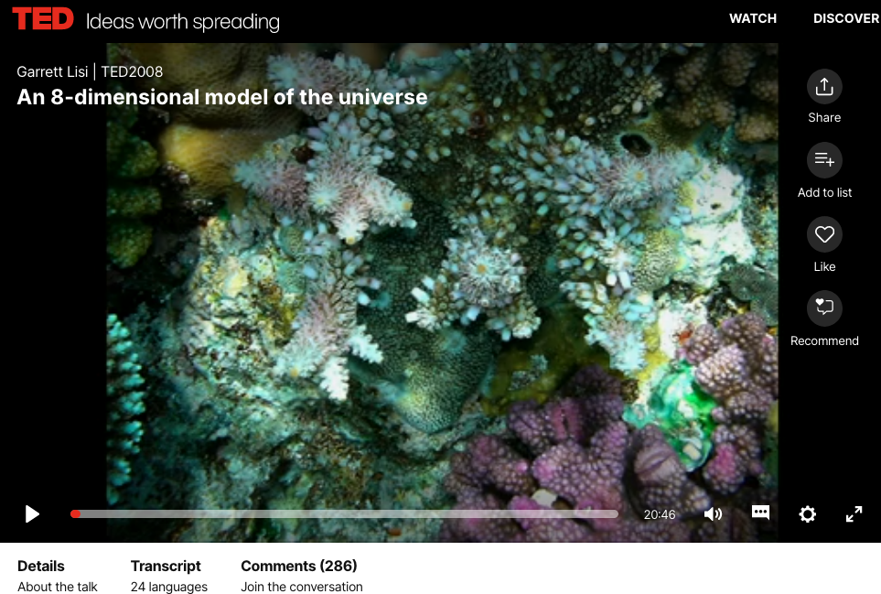
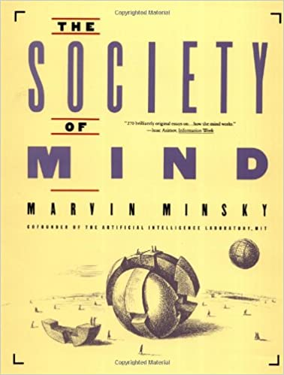
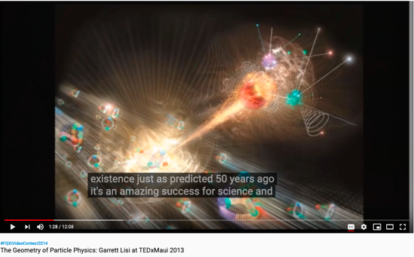
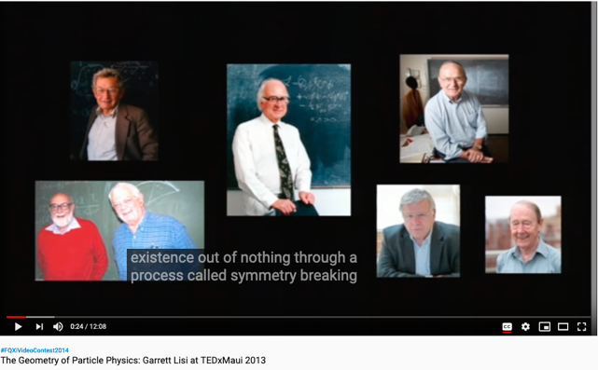
From Biology to Society of Mind
Online book: http://aurellem.org/society-of-mind/

Slide 5
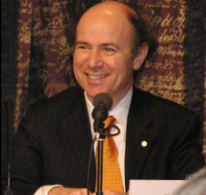
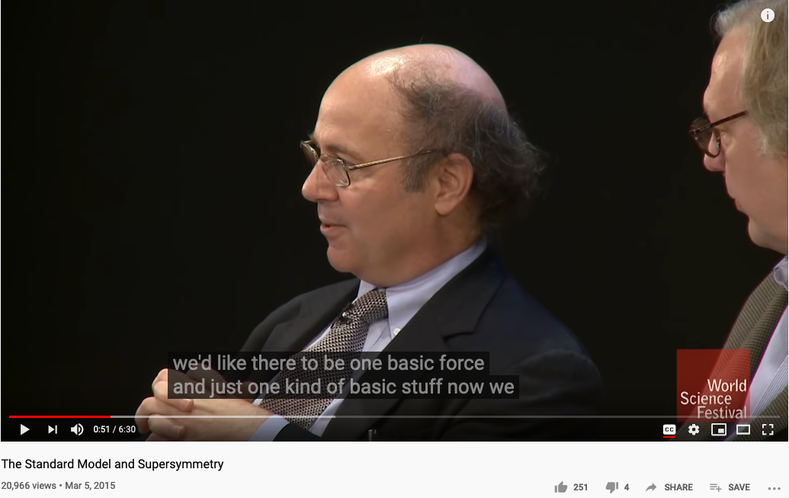
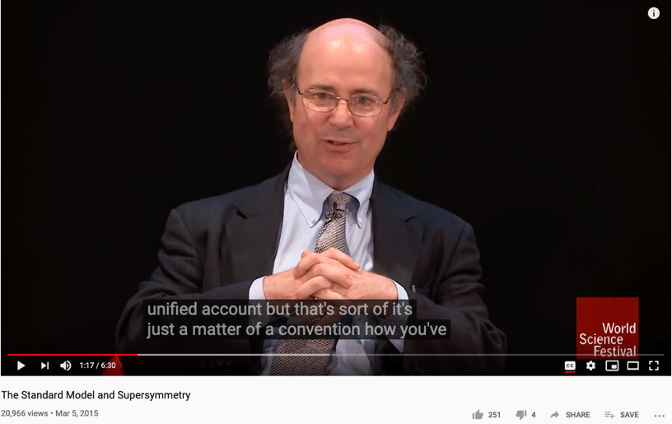
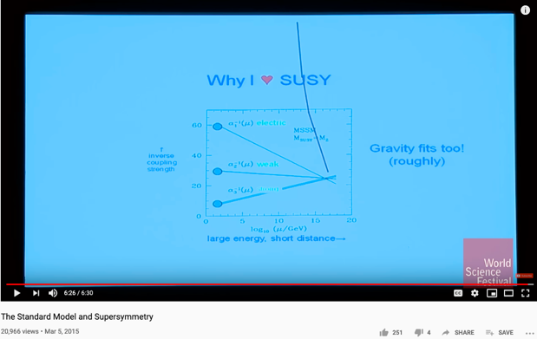
The Pursuit of a Unified Representation
Prof. Frank Wilczek of MIT, the Nobel Prize in Physics in 2004 "for the discovery of asymptotic freedom in the theory of the strong interaction."

Slide 6
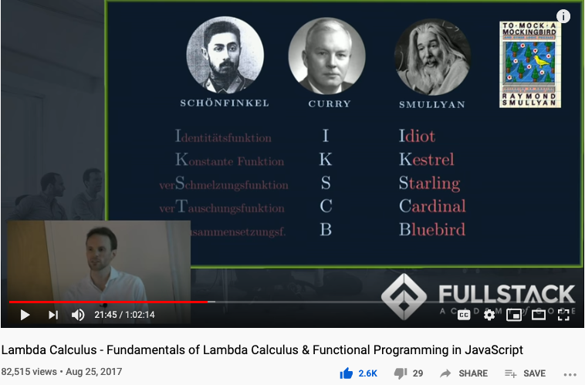
Computable Logic and Types of “Birds”

Slide 7
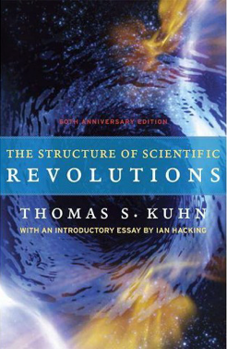

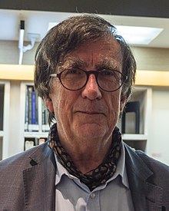

How Does Science Work?
Huawei VP Mr. Yang Shaoqing
Emerging cases or
systematic attacks
Normal Science
Model
Drift
Model Crisis
Model Revolution
Paradigm
Change
RICH 70 Tsinghua SEA Cloud Forum, Sep 14, 2020
H. E. Bambang Brodjonegoro,
Minister of Research & Technology, Indonesia

Slide 8
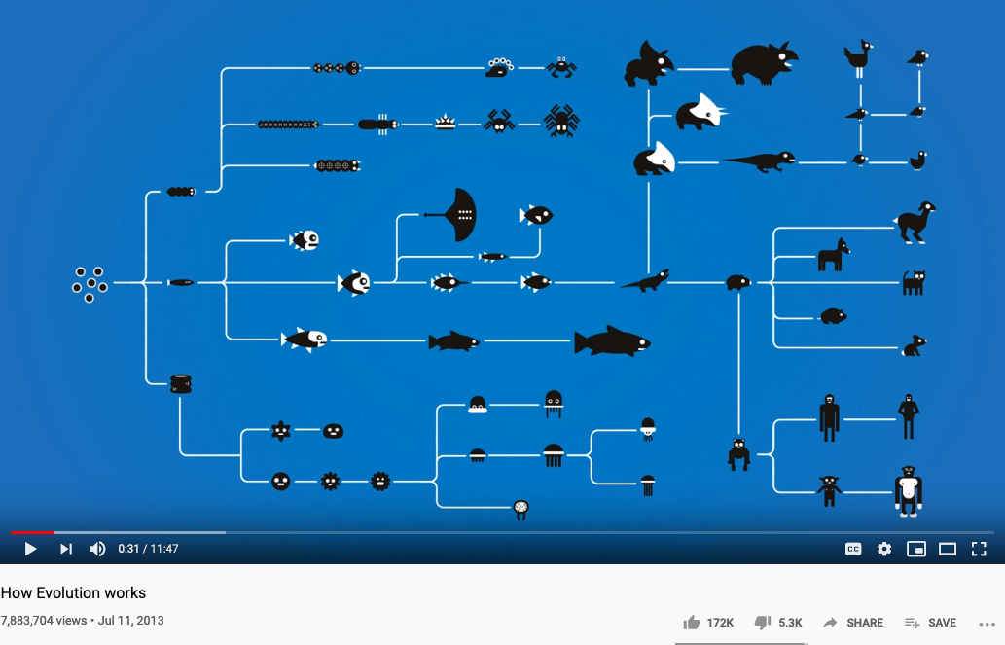
Biological Iterations and Branching

Slide 9
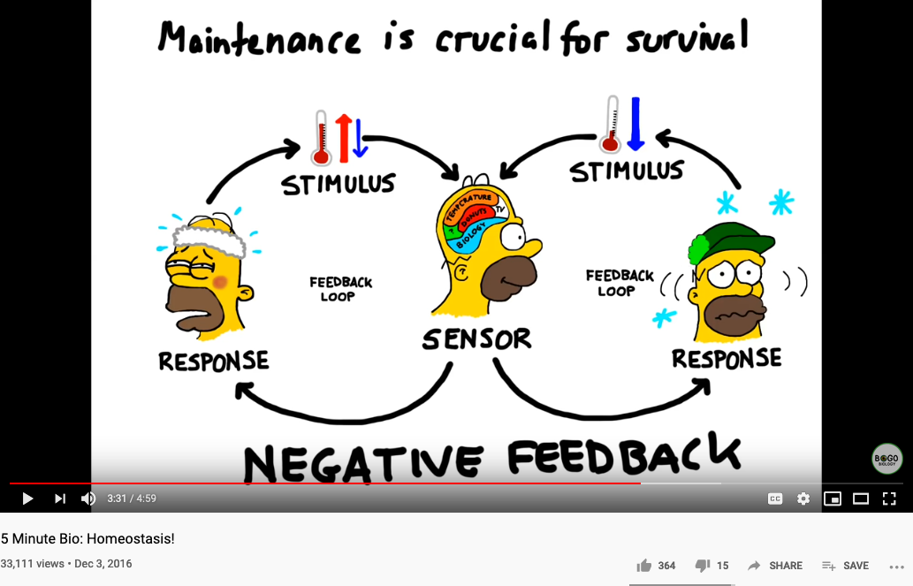
Biology and Physiology

Slide 10
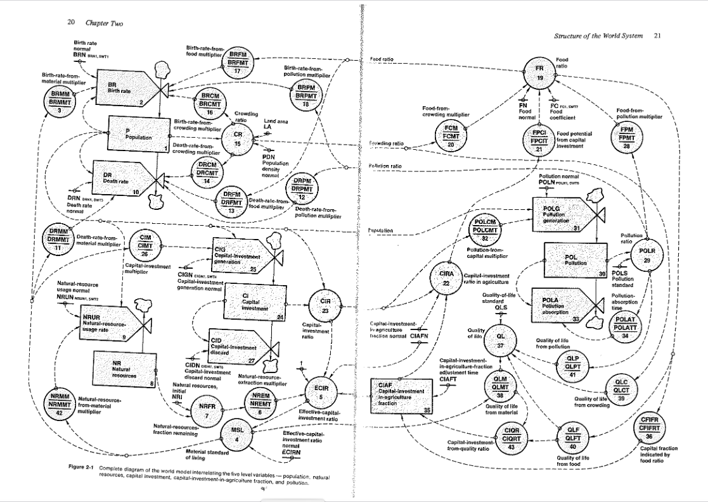
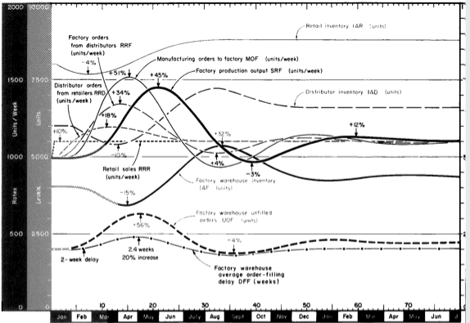
Industrial and World Dynamics

Slide 11
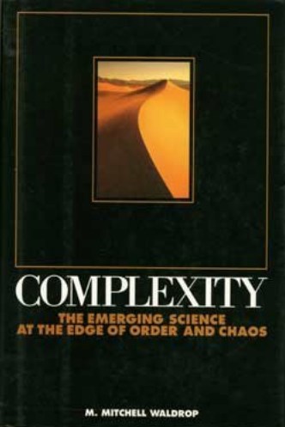
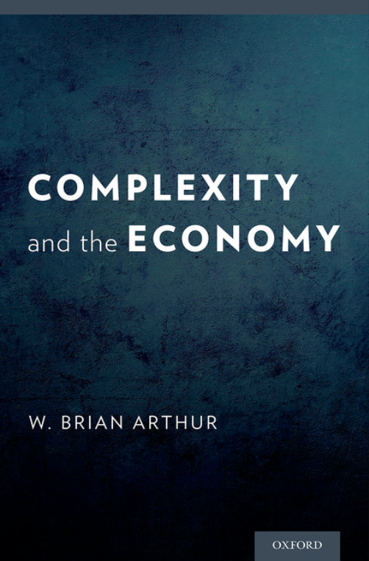
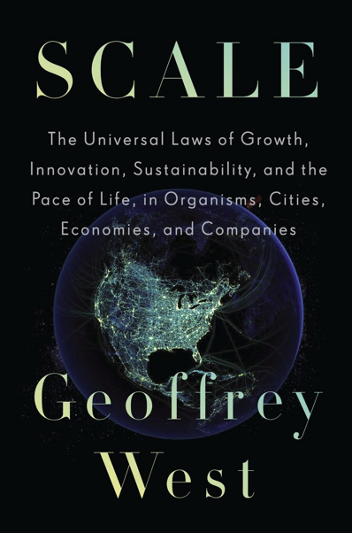
Scales: In Physical and Social Systems

Slide 12
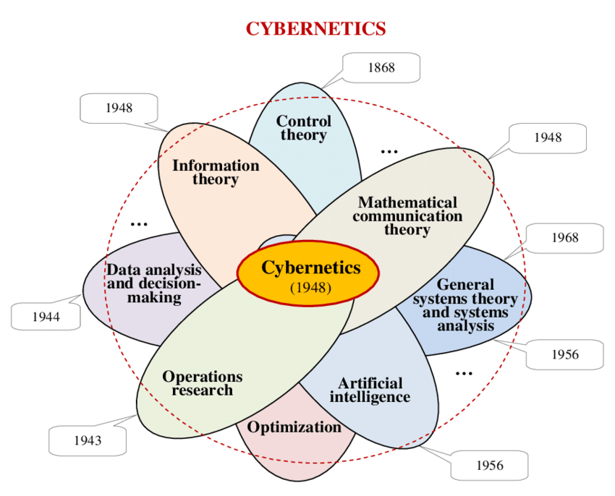
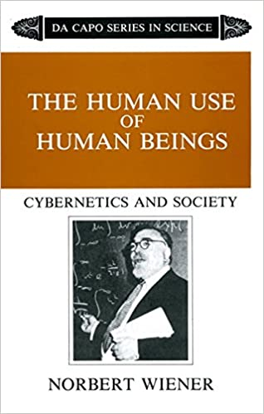
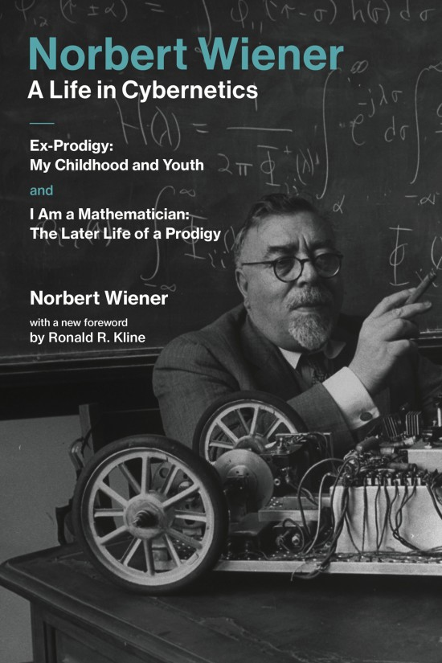
Cybernetics: Communication and Control

Slide 13
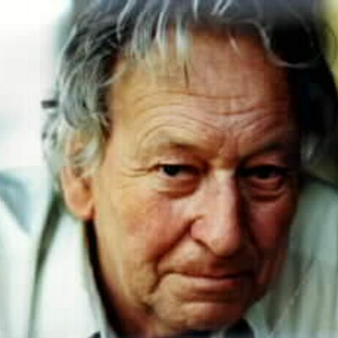

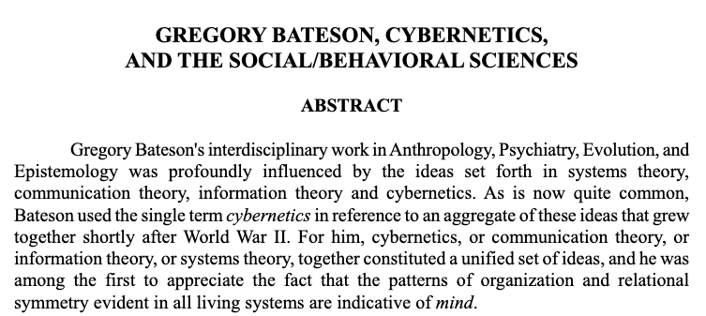


Cybernetics and the Social Behavioral Science

Slide 14
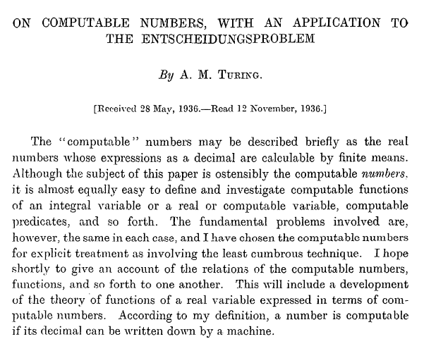
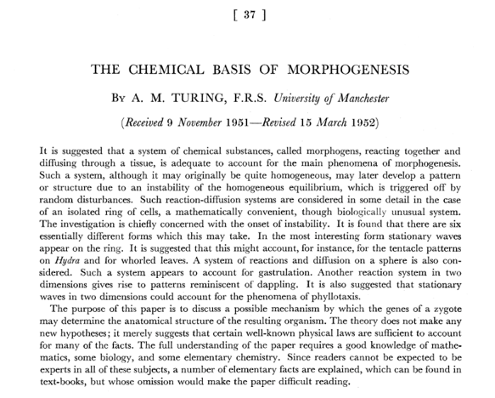
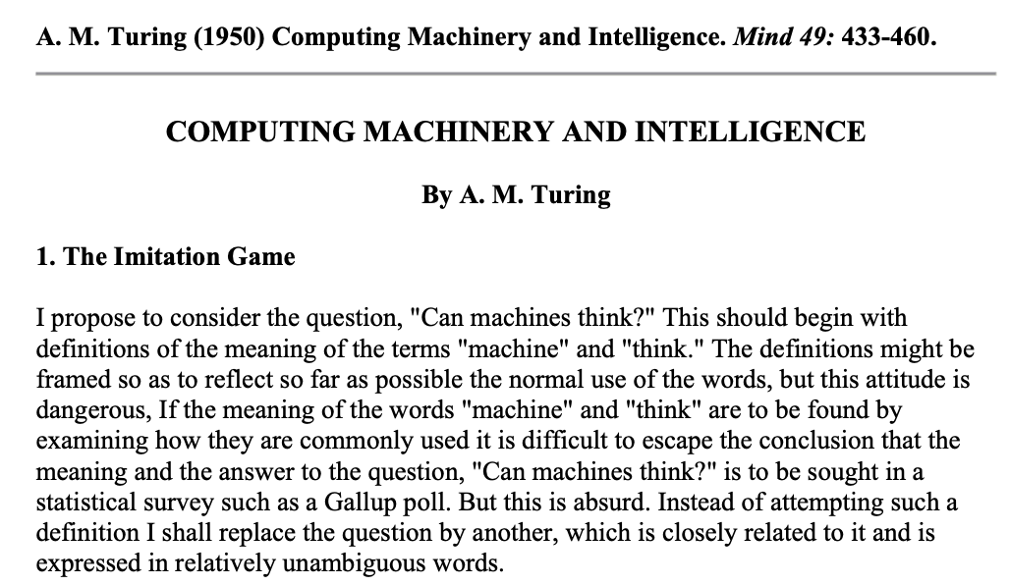
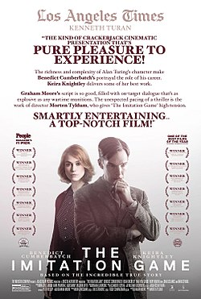
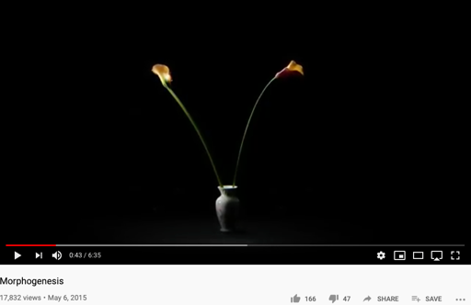
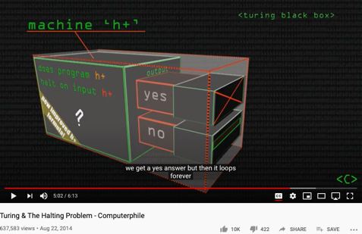
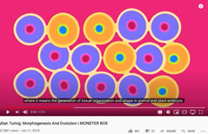
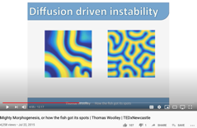
Alan Turing’s Papers
http://sitn.hms.harvard.edu/flash/2012/morphogenesis/
https://www.csee.umbc.edu/courses/471/papers/turing.pdf
https://www.mathtube.org/lecture/video/alan-turing-and-decision-problem

Slide 15
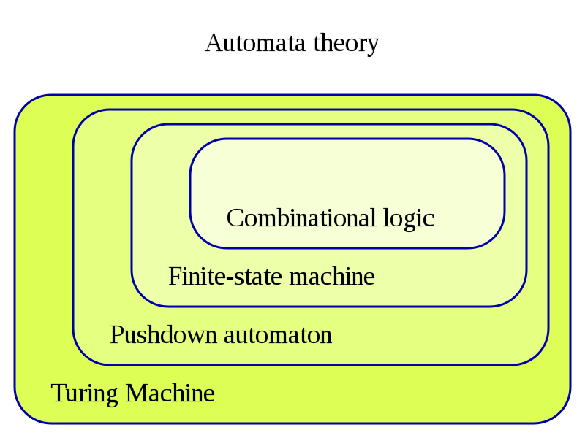
The Hierarchy of Complexity
Image Source: https://en.wikipedia.org/wiki/Turing_machine

Slide 16
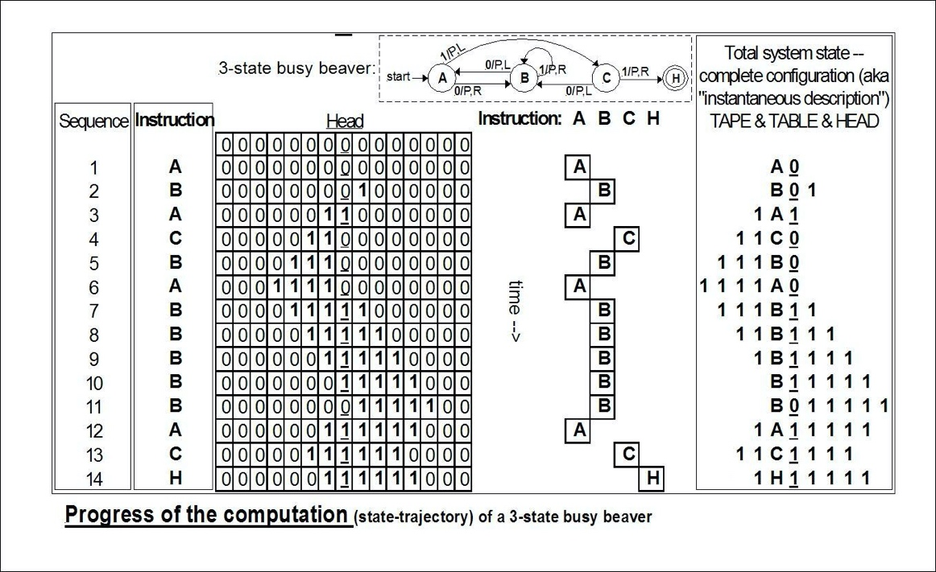
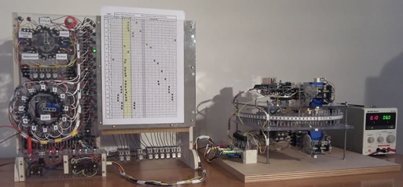
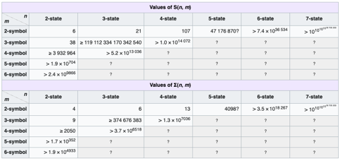
An example of Automaton
The state bounds of
busy beaver
(according to Wikipedia)
Image Source: https://en.wikipedia.org/wiki/Turing_machine

Slide 17
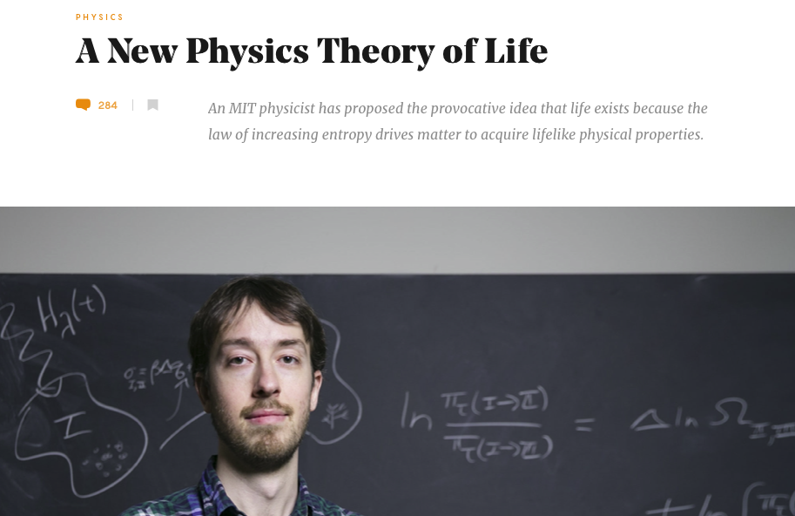
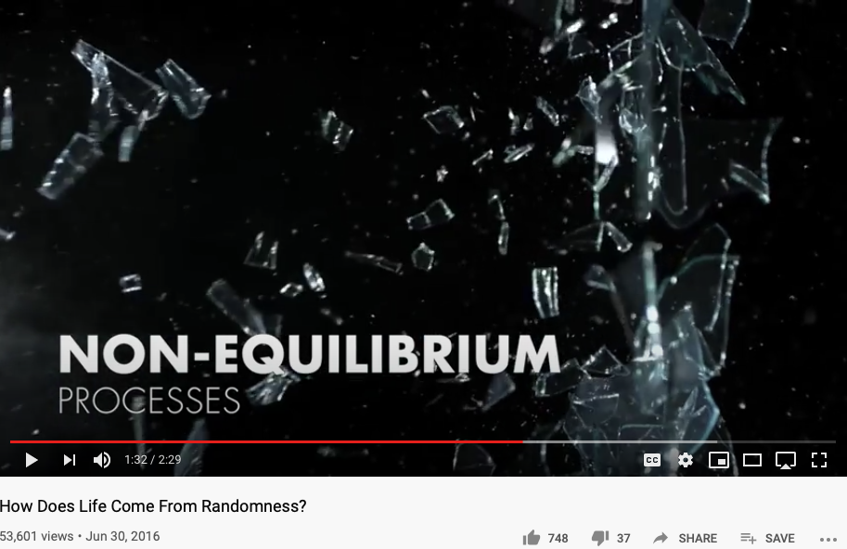
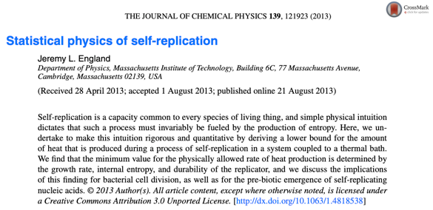
Non-Equilibrium Thermodynamics

Slide 18
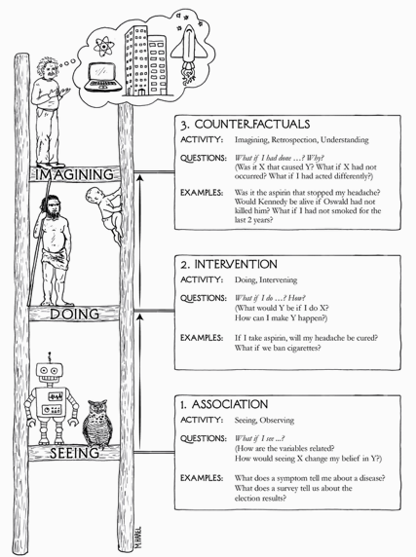

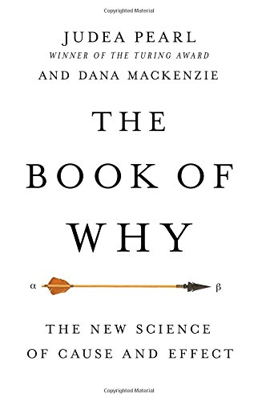
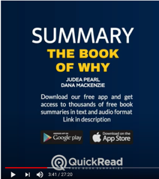
The Book of Why

Slide 19
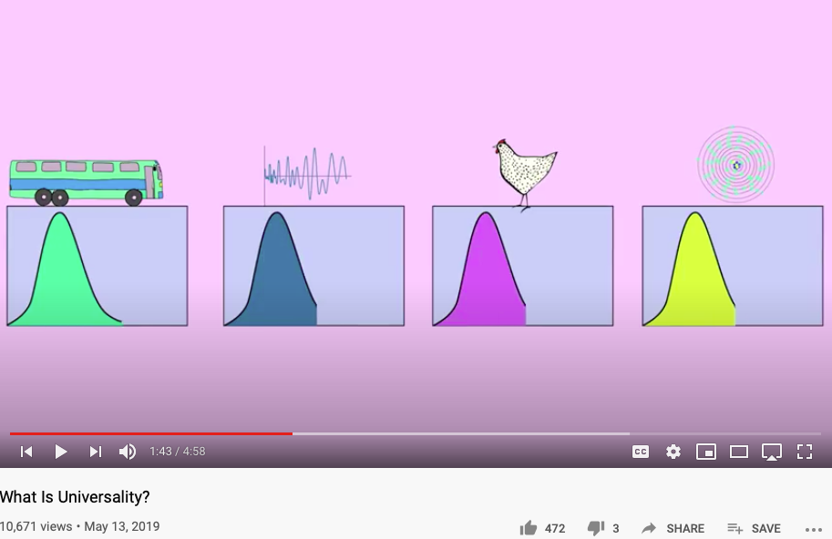
What is Universality?
What is in common between Bus Arrival, Riemann Zeta Function, Chicken Retina, and Quantized Energy?

Slide 20

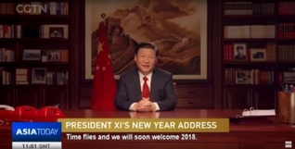
The Master Algorithm that will rule the world?
Bill Gates recommended this book
in 2016 Code Conference
President Xi’s
Bookshelf
The thesis:
Processing data through a single universal learning algorithm— can get all the knowledge from the past, the present, and the future
Pedro Domingos, TMA, P. 25
Chinese Translation
20

Slide 21
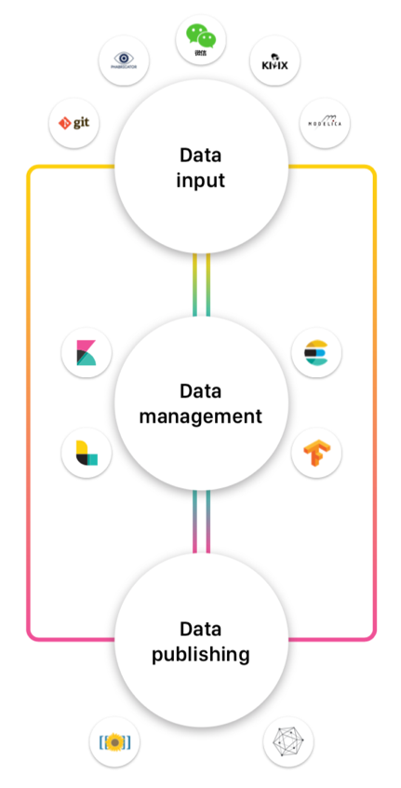
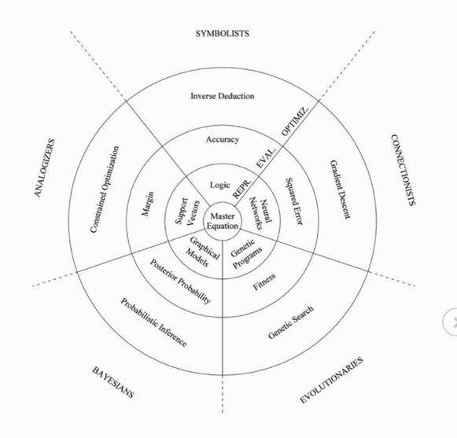
A Universal Declaration for Digital Rights
Image Source: extensis.com
https://www.extensis.com/blog/digital-asset-management/bringing-workflow-into-the-digital-asset-management-space/
Image Source: Master Algorithm
Score Keeping Tech for Digital Asset Exchanges
Automated Tools for Asset Refinement and Production

Slide 22
Summary
Homeostasis comes from Feedback Loop
Non-Equilibrium Homeostasis are rare compared to the majority of matter states
Causality, Consciousness, and Statistical Correlation are hardly separable.
Data Science is Universal and Scale-Free
Applicable to Biology, Math, Physics, Society, or any Complex Systems

Slide 23
Students Actions before Monday October 5
Catching up on toyhouse.wiki:81 with all content
Use Templates for your weekly learning summary
Create a link in your personal page to your Final report page
Work with other students as a team
Assign tasks to each other
Librarian, Writer, Mediator
Pick a topic and Create an outline

